Slide 1

Dependency Injection
by Alex Joslin

Slide 2
Dependency Injection
The idea that objects should not have to know how to construct a service, instead it is provided with the dependency by an external “injector’ which it is not aware of.
Decoupiles
Solves these Issues:
How can a class be independent from the creation of the objects it depends on?
How can an application, and the objects it uses support different configurations?
How can the behavior of a piece of code be changed without editing it directly?

Slide 3
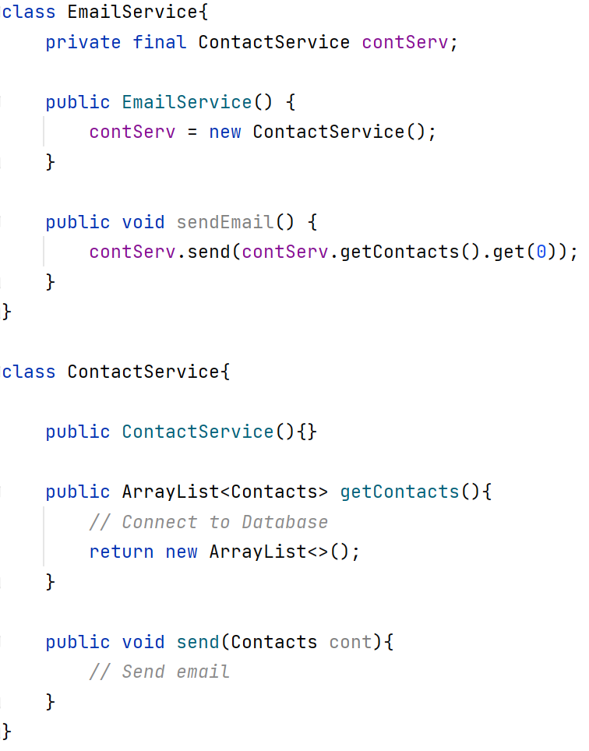
Bad Code
Here then email service is dependent on the contact service.
Every time a EmailService is instantiated, ContactService is also instantiated.
Creating bunch of objects.
They are stored on the heap.

Slide 4
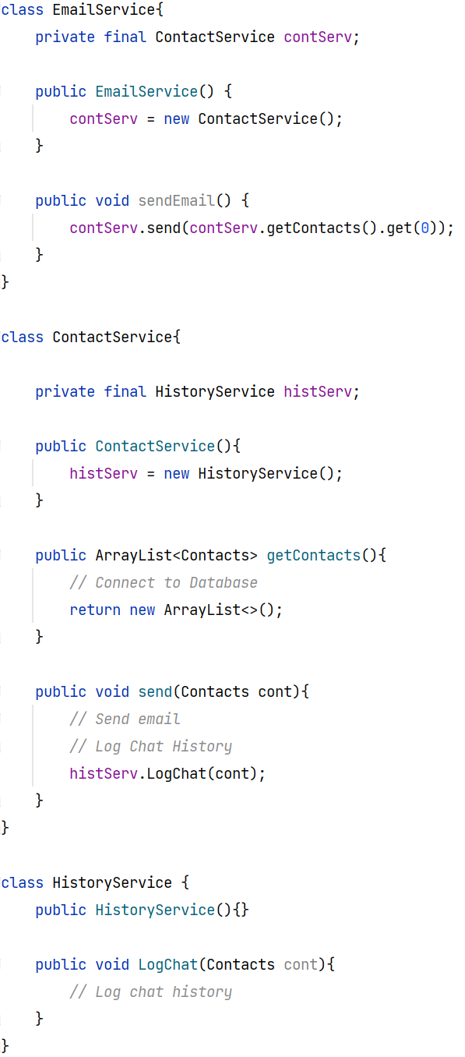
Bad Code
In this case we have EmailService dependent on ContactService and ContanctService dependent on HistoryService.
In enterprise systems you may have 100 different services connected to each other.
Testing becomes a nightmare. If you want to test a service but that service depends on other services that are not available you have a problem.

Slide 5
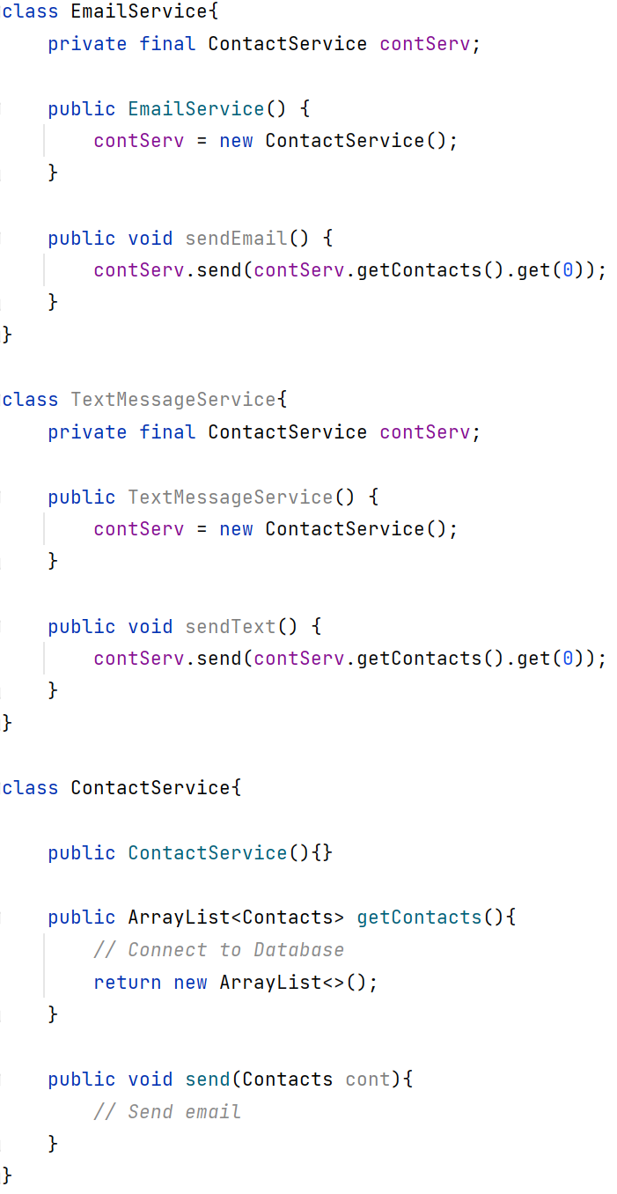
Bad Code
Here we have both EmailService and TextMessageService depending on ContactService.
If ContactService happens to be a singleton class problems can occur.
What is the point of creating 2 new ContactServices objecs?
If wrote a new subclass of ContactService, and wanted to use it instead, you would have to change everywhere you have new ContactService()

Slide 6
Bad Code

Slide 7
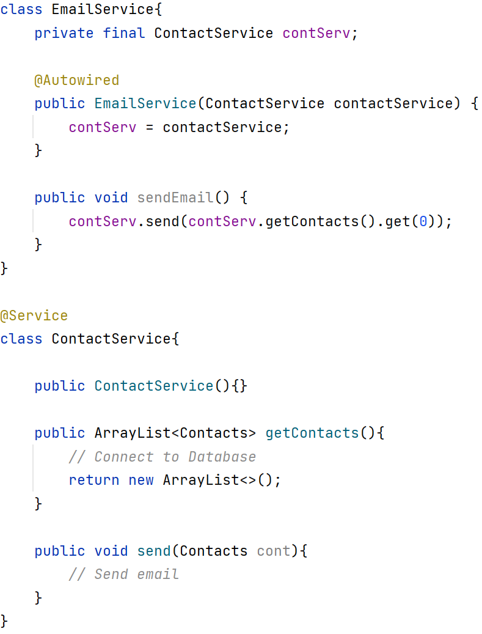
Good Code

Slide 8
Terms
Tight coupling is when a group of classes are highly dependent on one another.
Loose coupling also known as “separation of concerns” aims in making classes indecent of each other so that they can be easily used and tested without worrying about their dependencies.

